Slide 1


FREELANCER
Marketplace
Notes:
Image placeholder:
To add your image only you need to drag and drop it into the slide.

Slide 2
WELCOME
Notes:
Image placeholder:
To add your image only you need to drag and drop it into the slide.

Slide 3
What is The problem !?
01
The Unemployment
02
Additional income
When young people are unemployed, a vast potential is being lost.
This enables participants to sell their products and earn additional income in order to improve their lives.
03
Monopoly
0
The monopoly of the freelance marketplace by the hsoub in the middle east should be broken.

Slide 4


Slide 5







TOP
FREELANCER
Marketplace
A freelancer or freelance worker, is a term commonly used for a person who is self-employed and is not necessarily committed to a particular employer long-term. Freelance workers are sometimes represented by a company or a temporary agency that resells freelance labor to clients; others work independently or use professional associations or websites to get work.
en.wikipedia.org/wiki/Freelancer
8/4/2019
Notes:
Image placeholder:
To add your image only you need to drag and drop it into the slide.

Slide 6
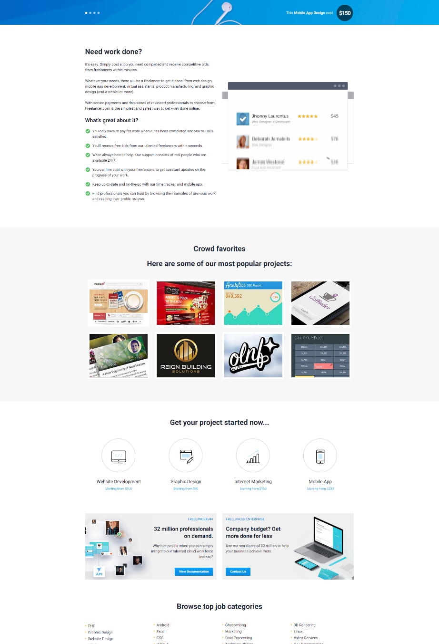
Freelancer
Freelancer is a global crowdsourcing marketplace website, which allows potential employers to post jobs that freelancers can then bid to complete. Founded in 2009, its headquarters is located in Sydney, Australia, though it also has offices in Southern California, Vancouver, London, Buenos Aires, Manila, and Jakarta.
Notes:
Image placeholder:
To add your image only you need to drag and drop it into the slide.

Slide 7
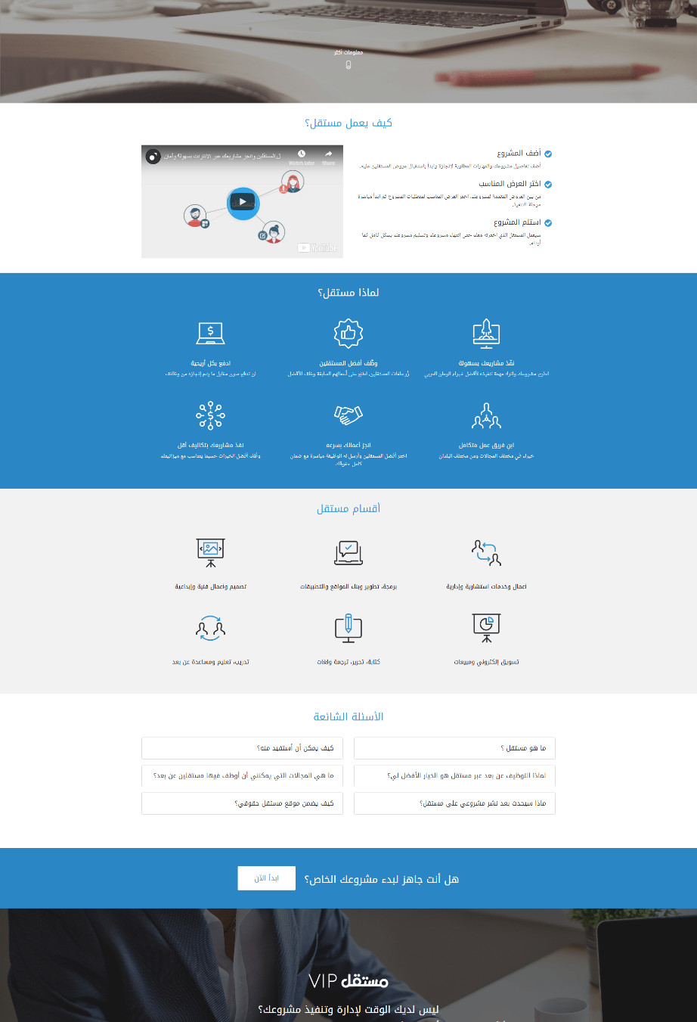
Mostaql
مستقل هو منصة العمل الحر للمستقلين في الوطن العربي.
يهدف مستقل لإيجاد منصة عربية تتيح لأصحاب المشاريع والشركات التعاقد مع مستقلين محترفين للقيام بأعمالهم الكبيرة والصغيرة، وبنفس الوقت يتيح للمستقلين المحترفين مكانا لإيجاد مشاريع يعملون عليها ويكسبون من خلالها.
Notes:
Image placeholder:
To add your image only you need to drag and drop it into the slide.

Slide 8
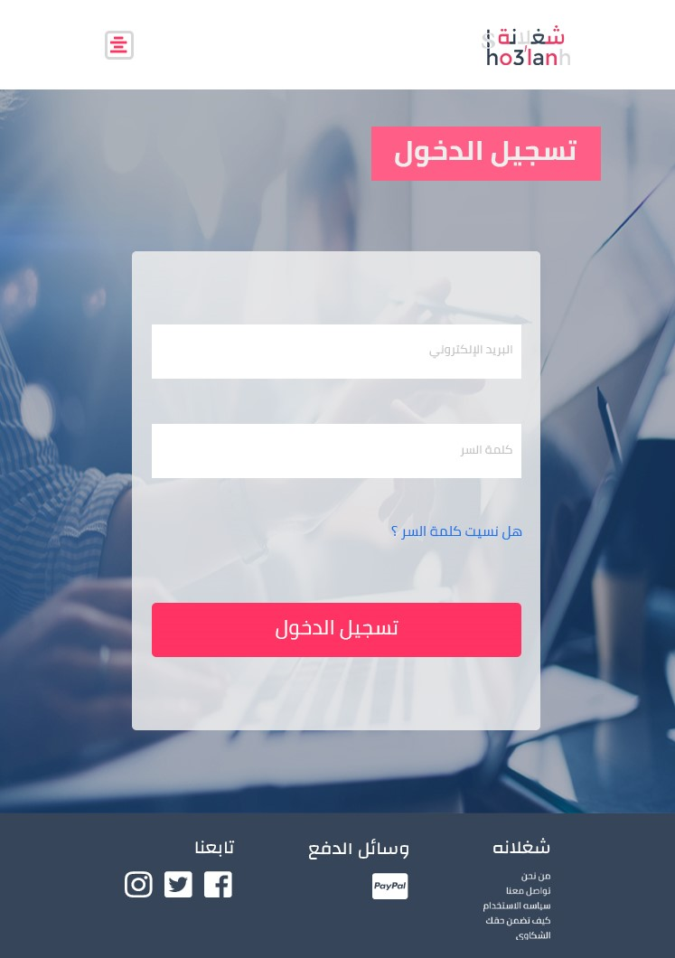
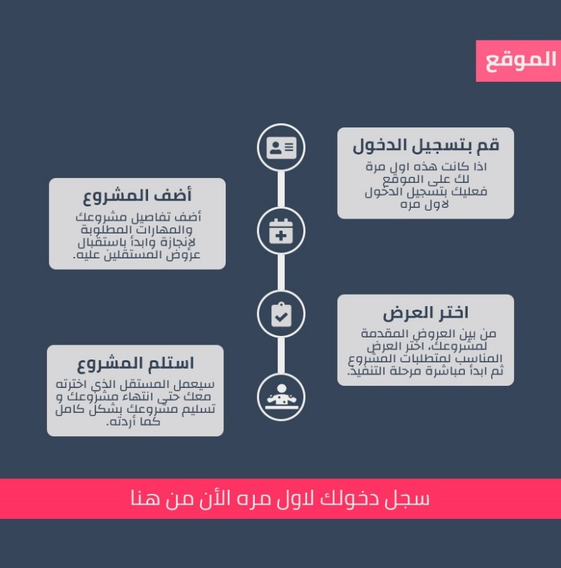
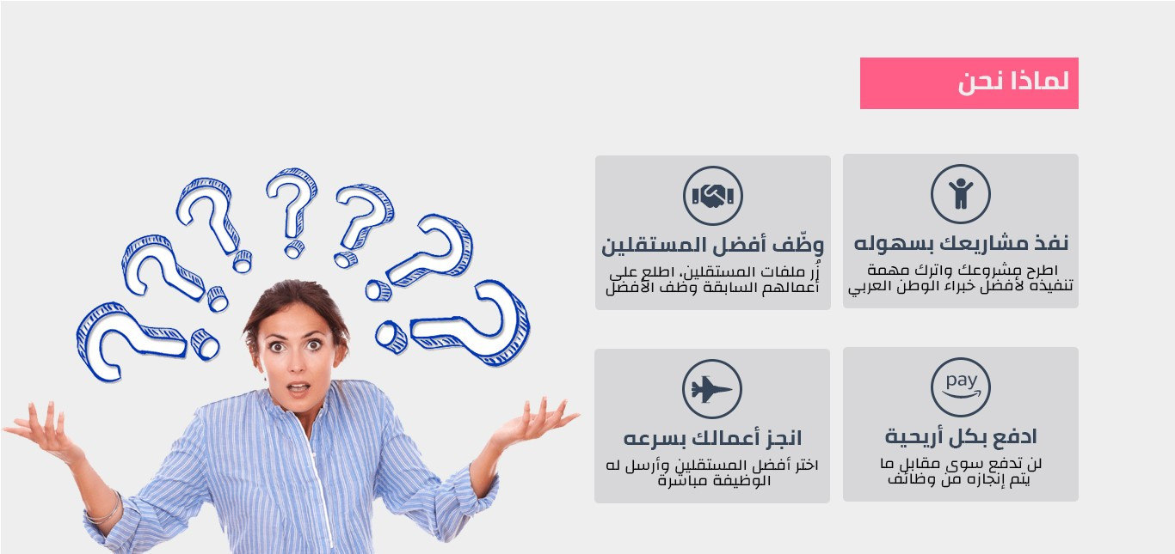

How We Can Do That !
Make it easy to use
Avoid defects
Make some thing new
Care about user interface and user experience .
Help The Freelancers and buyers .
Strong Portfolio , The provision of services, Rating and more …
Notes:
Image placeholder:
To add your image only you need to drag and drop it into the slide.

Slide 9

System Analysis
Context level
Diagram 0
Entity–Relationship
Diagram
Schema
Notes:
Image placeholder:
To add your image only you need to drag and drop it into the slide.

Slide 10
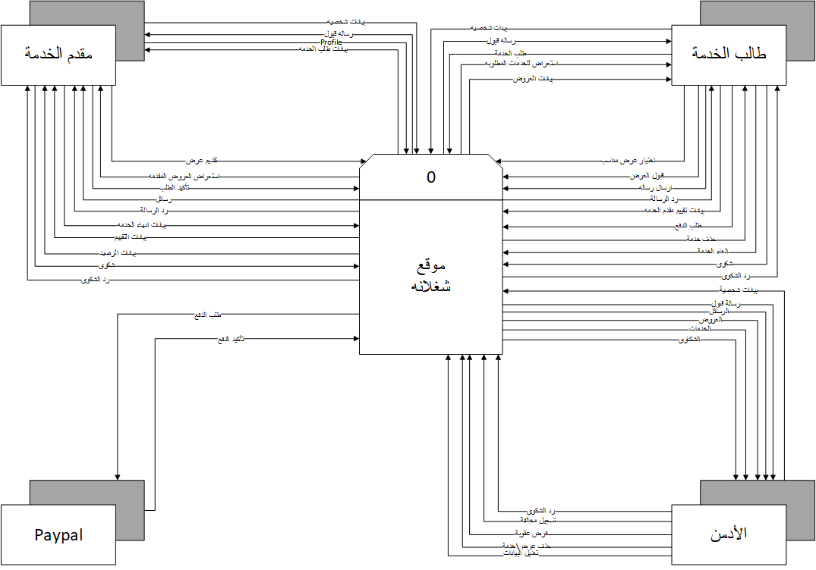

Slide 11
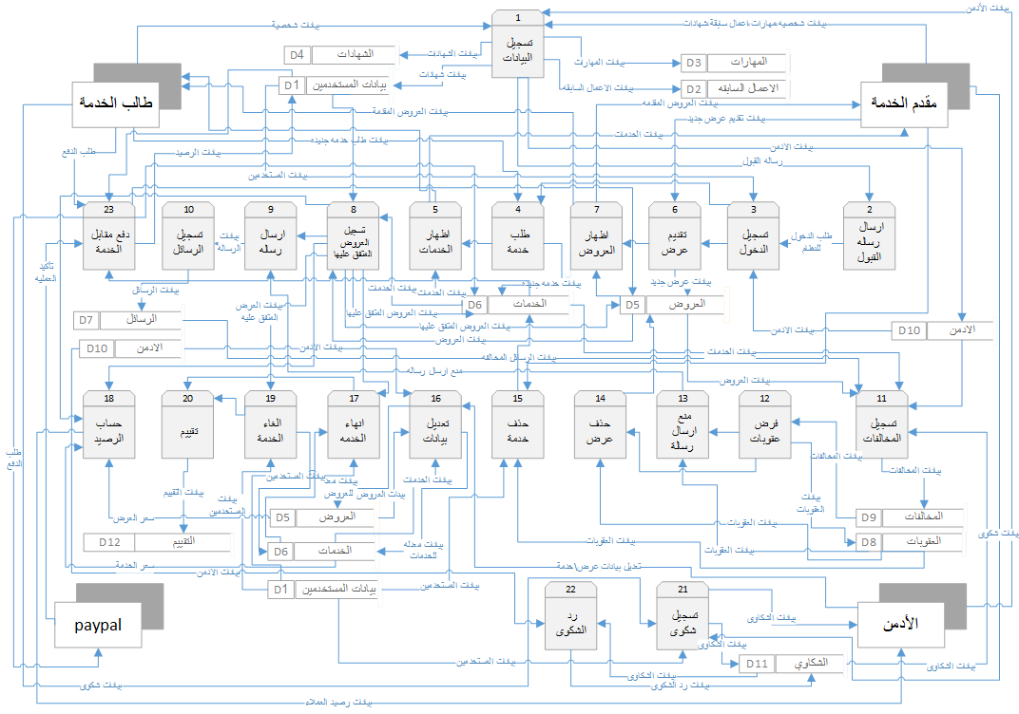

Slide 12
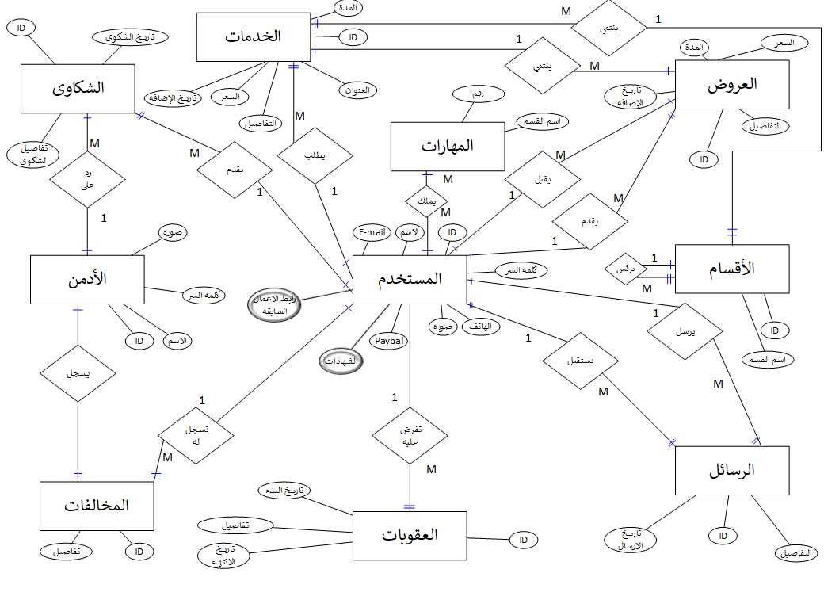

Slide 13
شكل (2-6) : Database Schema

Slide 14
For User
For Admin
For Developers
Good Browser .
E-mail .
PayPal Account.
Good Browser .
E-mail .
Business PayPal Account .
Few knowledge About Programing Languages & SQL .
Domain & Host .
HTML5, CSS3, JS.
XAMPP.
Photoshop & Adobe Illustrator .
PHP & MYSQL .
MS Office
Good Knowledge in Version-Control like GitHub

Slide 15




Responsive Web Design
In 2019 You Need Responsive website .
Use Frameworks To Help you .
Notes:
Image placeholder:
To add your image only you need to drag and drop it into the slide.

Slide 16


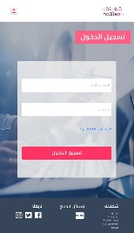
Notes:
Image placeholder:
To add your image only you need to drag and drop it into the slide.

Slide 17


Slide 18


Slide 20
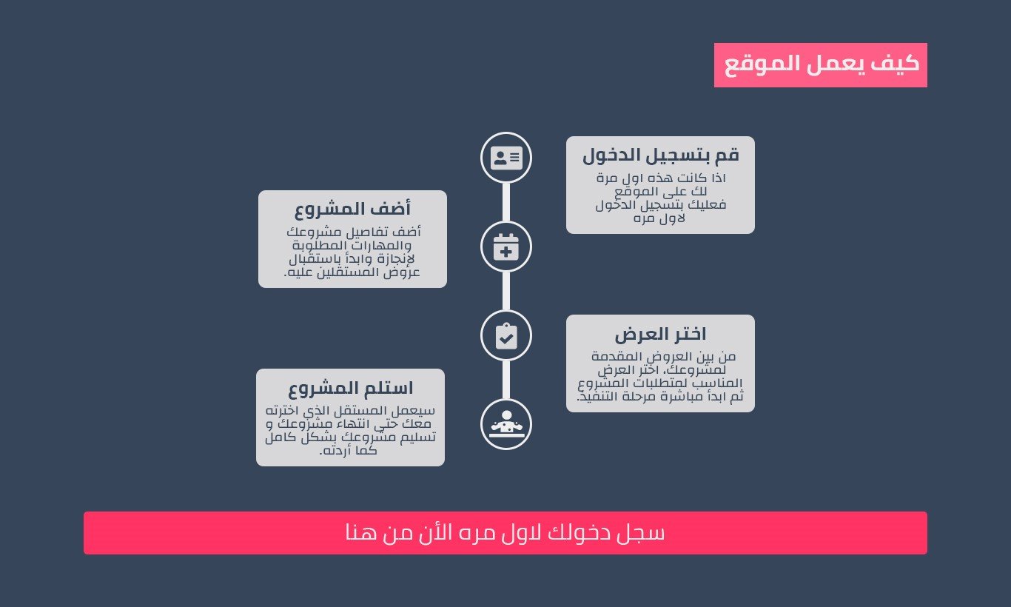

Slide 21


Slide 22


Slide 23
GOOD BYE
Notes:
Image placeholder:
To add your image only you need to drag and drop it into the slide.

